Slide 1

The Political Economy of Bundling Socio-Technical Innovations to Transform Agri-Food Systems
Christopher B. Barrett
Cornell University
IFPRI Book Launch Event
Washington, DC
November 14, 2023

Slide 2
Why socio-technical innovation bundles?
  The main obstacle to AFS transformation is not supply of suitable innovations. It is the political economy of diffusing/scaling context-appropriate innovations.
The political economy need for STIBs arises because:
Multiple objectives & heterogeneous preferences/interests
Innovations generate both losers & winners (‘creative destruction’).
This naturally generates resistance to innovations, especially given people’s greater sensitivity to headwinds than tailwinds.
Innovations offer only potential Pareto improvements.

Slide 3
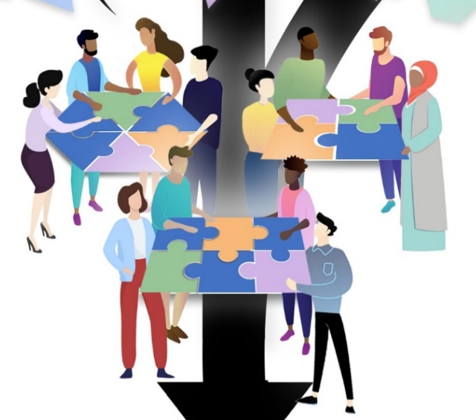
Building Coalitions
Bundling innovations can turn potential Pareto improvements into actual Pareto improvements. One innovation that satisfies the Kaldor-Hicks compensation criterion can compensate for another. So bundle together to form coalitions to overcome humans’ innate conservatism.
This requires coordinated human agency, i.e., sound institutions that both empower all and hold all accountable. Excessively concentrated power commonly obstructs coalition formation. Logic of collective action can also lead to minority interest group domination.
Misinformation another big challenge to coalition formation b/c impedes identification of potential PIs. Fosters subjective uncertainty and conservative opposition to innovations.
Trust is central to coalition formation and maintenance.
Co-creation of STIBs can build trust.

Slide 4
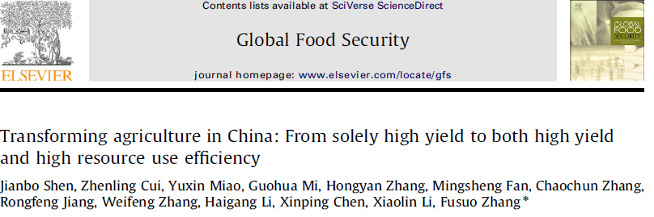
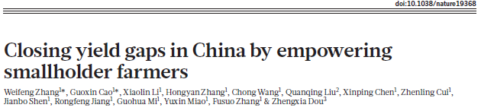
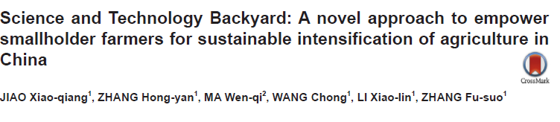
Ex 1: China’s Science and Technology Backyards
Started in 2009, participatory research and extension program at (huge) scale.
Brought together different interest groups - researchers, farmers, commercial input suppliers/traders, local gov’ts – to identify and evaluate contextualized innovation bundles.
Good example of both (i) localized co-creation as a trust-building process, and (ii) logic of collective action in coalition formation: strength of small interest groups + numbers of large latent support groups.
Ultimately, 127 STBs in 23 provinces and engaging 10s millions farmers. Accelerated discovery, diffusion and impacts.
(For more details, see http://chinastb.com/ .)

Slide 5
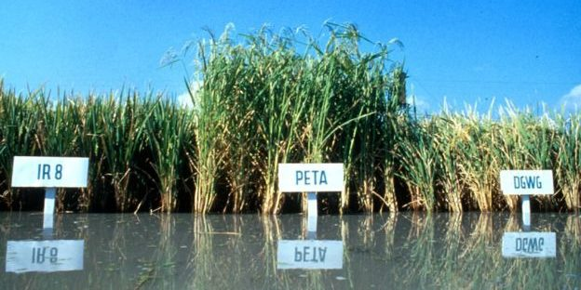
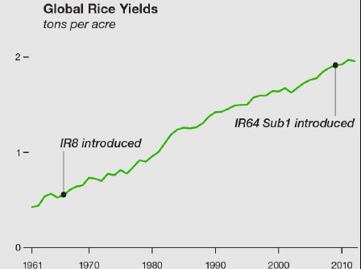
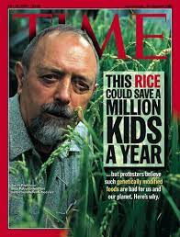
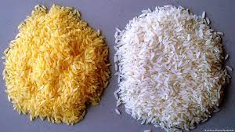
Ex 2: Genetic Improvement in Rice in Asia
Story of Green Revolution rice is inspiring. But success was not inevitable. Had to overcome initial resistance by building coalitions to support diffusion of new varieties. Required a coalition of champions for different, complementary innovations: irrigation, new varieties, electrification, roads, marketing and price stabilization policies, etc.
By contrast, transgenic golden rice, still has not had any measurable impact >20 years after its discovery. Big obstacle: misinformation and logic of collective action favoring an opposition movement.

Slide 6
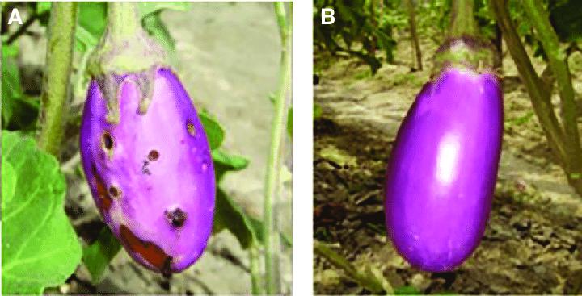
Ex 3: The Irony of
Bt brinjal in South Asia
Transgenic brinjal (eggplant) developed in India to resist borers. Obstructed in India by anti-GM movement, based largely on misinformation campaign playing to intrinsic conservativism. Moratorium imposed by Minister of Environment and Forests despite approvalsthat concluded Bt brinjal safe and beneficial and despite past approval of Bt cotton in India. Harder to build coalition for brinjal than cotton.
Bt brinjal was Bangladesh’s first GM crop release.
Pesticide importer not exporter. Pushed labeling to address concerns
about farmer choice and information.
The political economy of coalition building helps explain the differential uptake of Bt brinjal between India and Bangladesh.

Slide 7
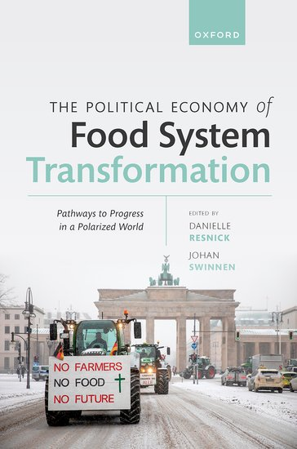
Thank you
Congratulations and thanks to Danielle and Jo … and to all contributing authors.
A must read book!

